Slide 1
THE JOY AND EXCITEMENT OF
FORBIDDEN
COMPUTING
kate temkin, !!con 2021

Slide 2

SO, WHO aM ‘I’?
Katherine/Kate Temkin (@ktemkin):
easily nerd-sniped (by problems she shouldn’t solve)
lead digital witch at Great Scott Gadgets
open-source-tool-builder
educational (reverse) engineer
one human person, within a margin of error

Slide 3
PROPOSAL:
GOOD COMPUTING IS HUMAN-FOCUSED

Slide 4
TODAY’S EXAMPLE:
JOY FROM NON-FORBIDDEN COMPUTING

Slide 5
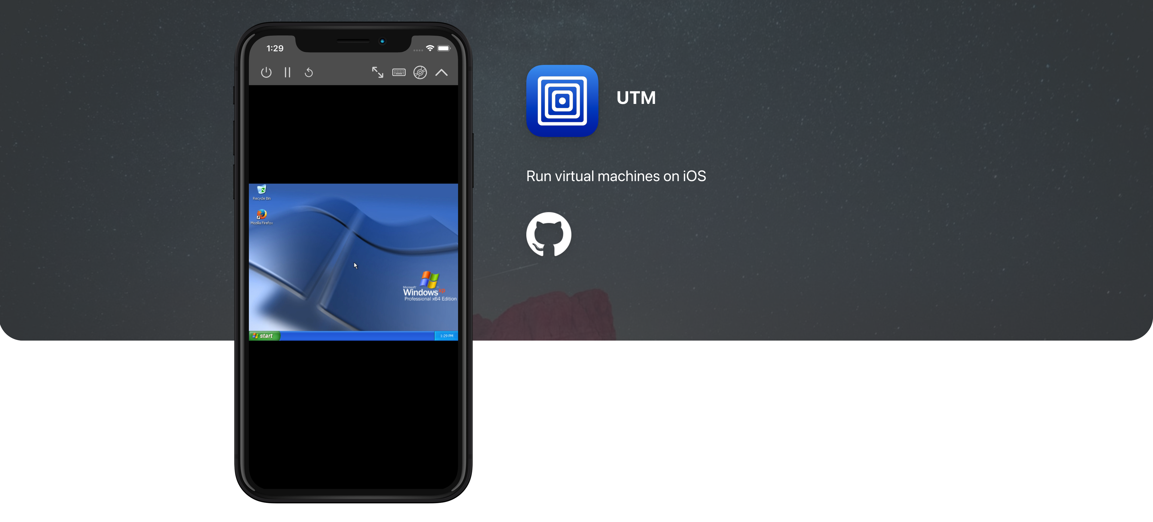
UTM: virtual machines for iOS
a speedy QEMU-based full-machine emulator
for Apple devices
source: getutm.app

Slide 6
UTM: virtual machines for iOS
a speedy QEMU-based full-machine emulator
for Apple devices running older versions of iOS
source: getutm.app

Slide 7
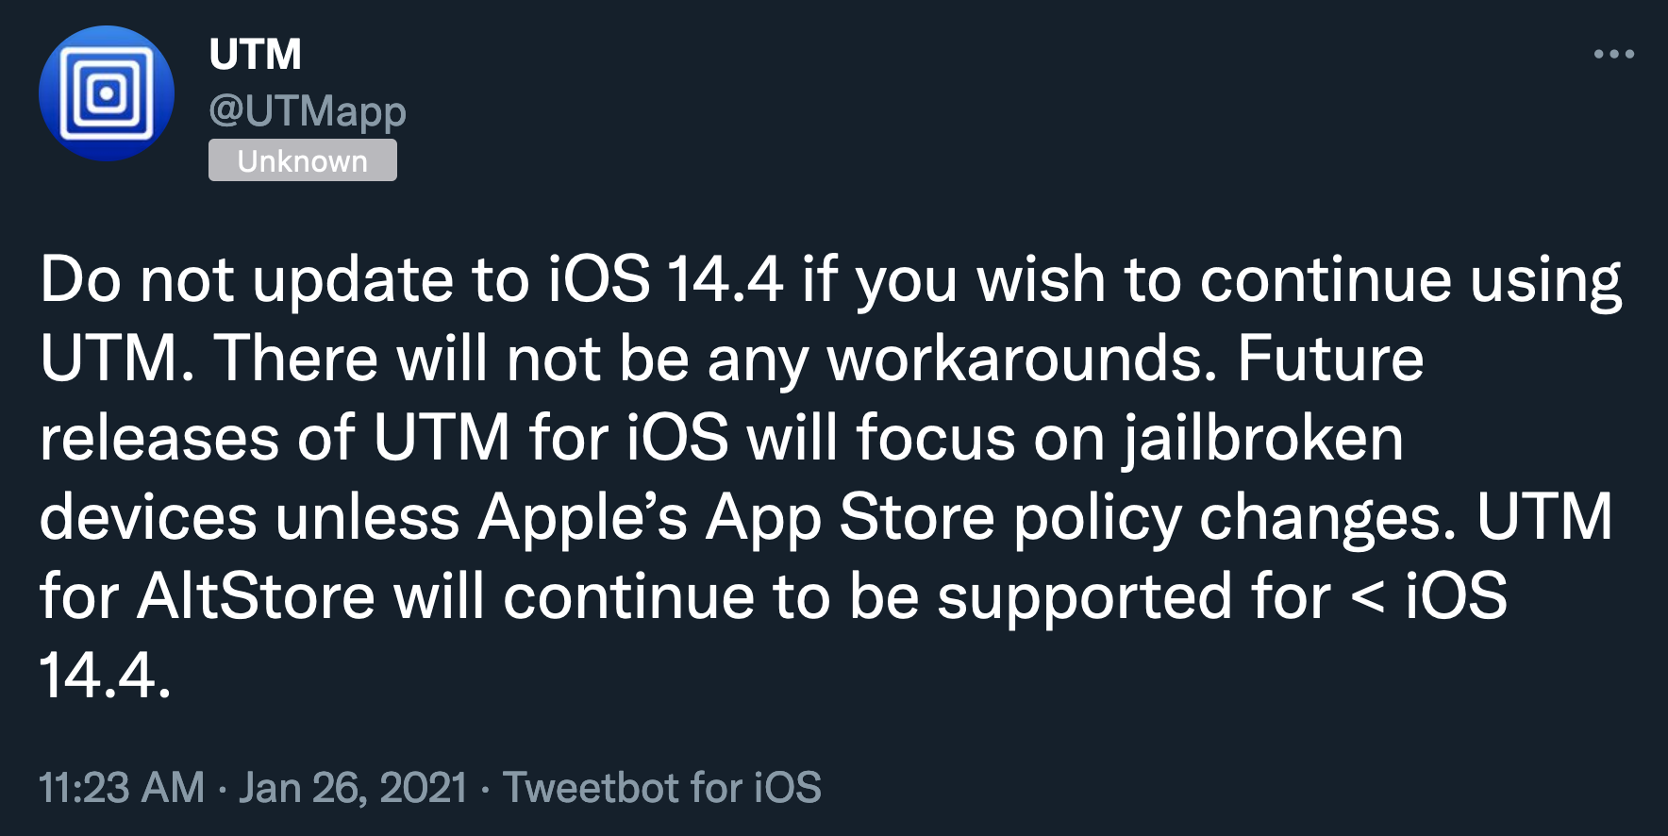
😢
STATUS: COMPUTATIONALLY FORBIDDEN

Slide 8
SO:
HOW DID THIS HAPPEN?

Slide 9
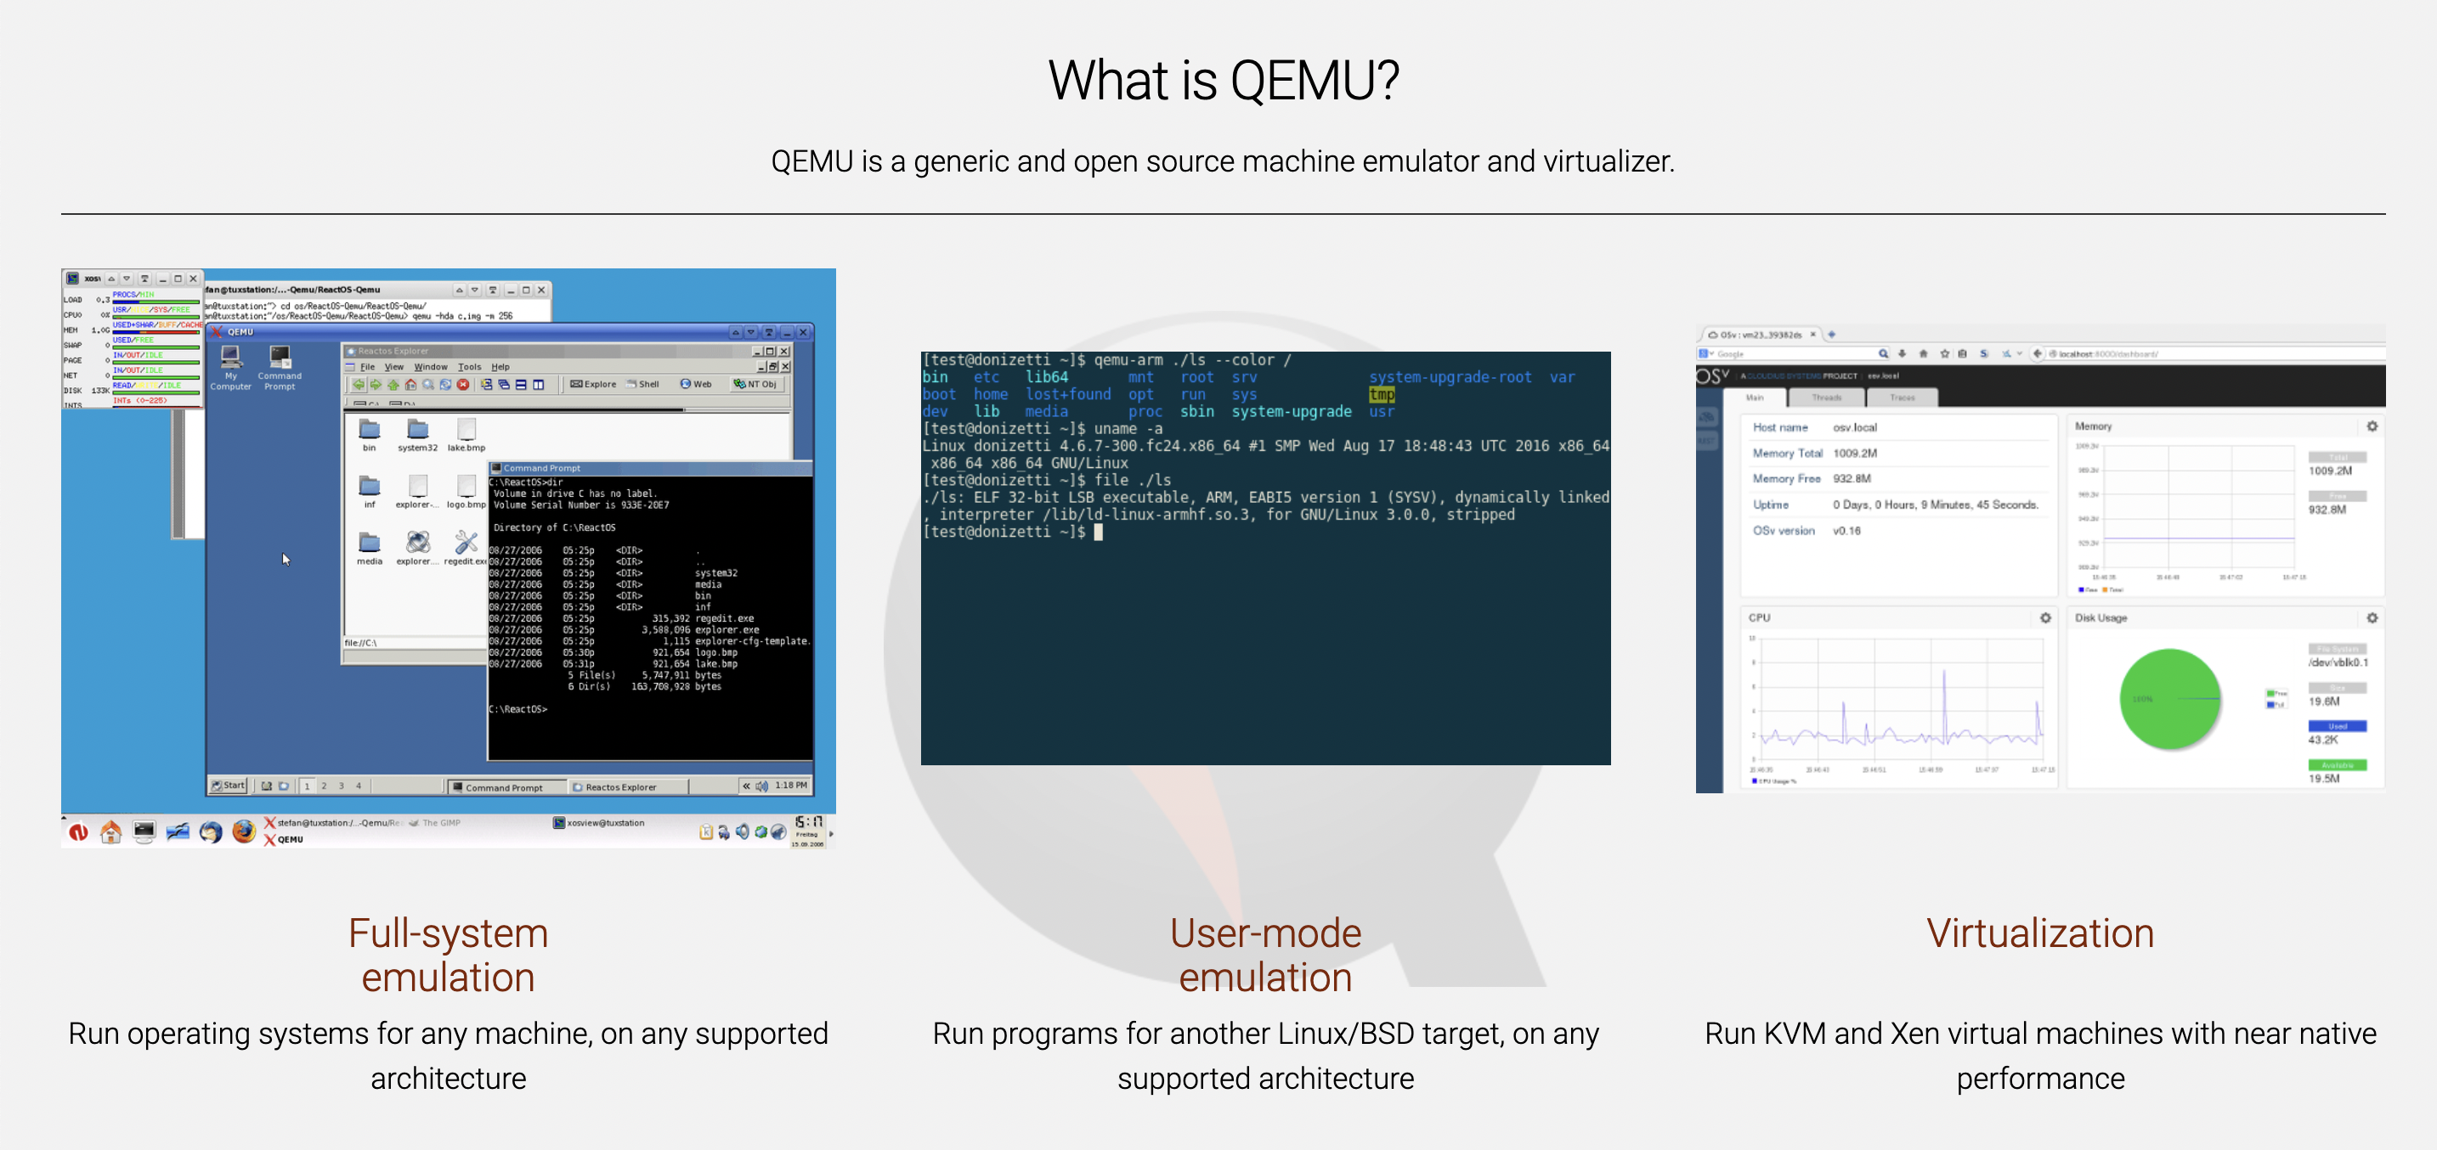
SO:
HOW DID THIS HAPPEN?
source: qemu.org

Slide 10
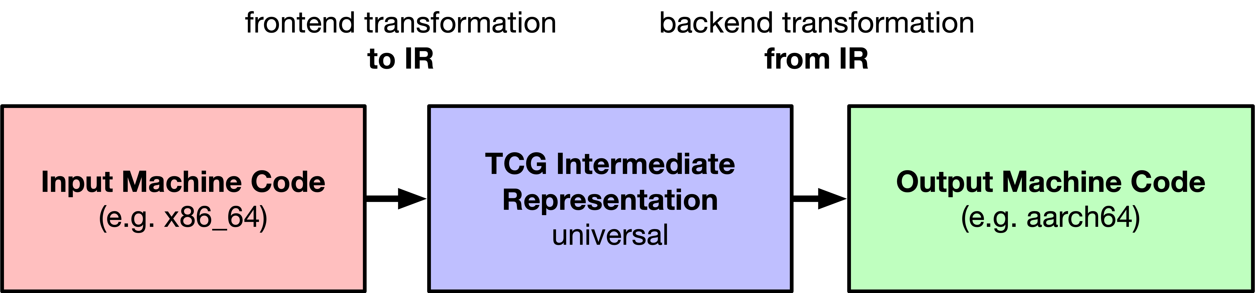

Slide 11
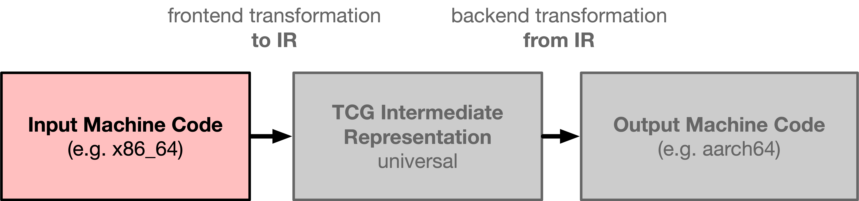
xorl %r8d, %r8d
movl $0x40000, %ecx
movl $0x100, %edx
movl $0x100, %esi
movq $18446744071850834489, %rdi
callq 0xffffffff90256d10

Slide 12
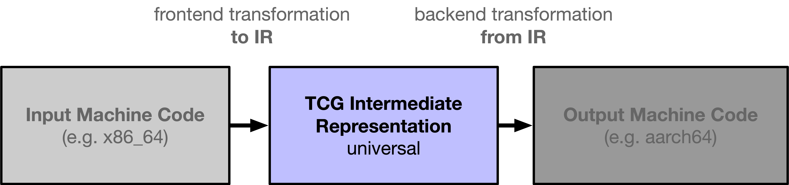
xorl %r8d, %r8d
movl $0x40000, %ecx
movl $0x100, %edx
movl $0x100, %esi
movq $18446744071850834489, %rdi
callq 0xffffffff90256d10
mov_i64 r8,$0x0
mov_i64 rcx,$0x40000
mov_i64 rdx,$0x100
mov_i64 rsi,$0x100
mov_i64 rdi,$0xffffffff91363a39
st_i64 $0xffffffff90256d10,env,$0x80
call lookup_tb_ptr,$0x6,$1,tmp21,env
goto_ptr tmp21

Slide 13
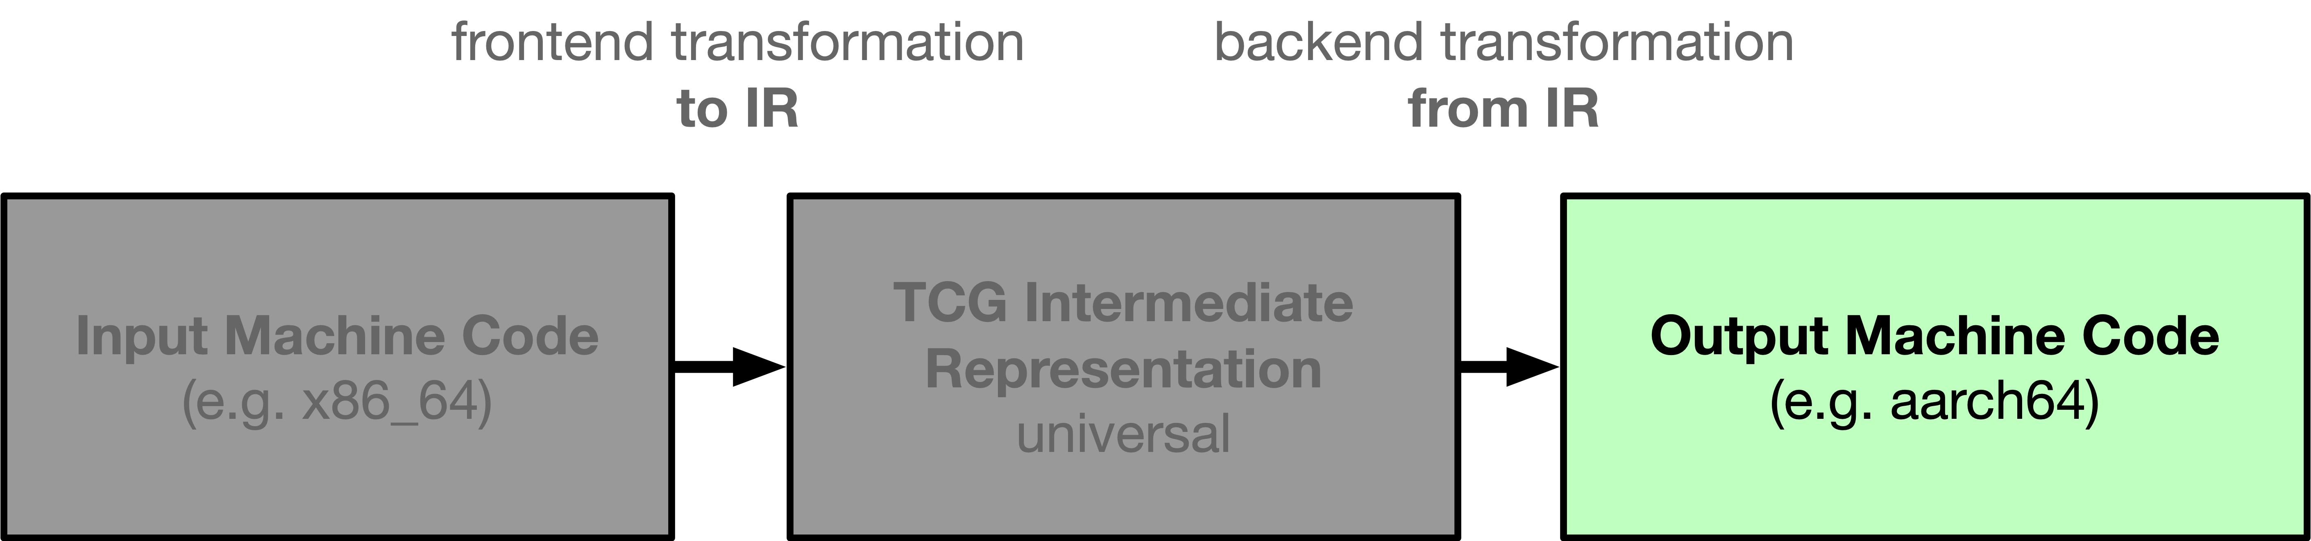
mov_i64 r8,$0x0
mov_i64 rcx,$0x40000
mov_i64 rdx,$0x100
mov_i64 rsi,$0x100
mov_i64 rdi,$0xffffffff91363a39
str xzr, [x19, #0x40]
orr w20, wzr, #0x40000
str x20, [x19, #8]
mov w20, #0x100
str x20, [x19, #0x10]
mov w20, #0x100
str x20, [x19, #0x30]
mov x20, #-0xc5c7
movk x20, #0x9136, lsl #16
str x20, [x19, #0x38]

Slide 14
xorl %r8d, %r8d
movl $0x40000, %ecx
movl $0x100, %edx
movl $0x100, %esi
movq $18446744071850834489, %rdi
str xzr, [x19, #0x40]
orr w20, wzr, #0x40000
str x20, [x19, #8]
mov w20, #0x100
str x20, [x19, #0x10]
mov w20, #0x100
str x20, [x19, #0x30]
mov x20, #-0xc5c7
movk x20, #0x9136, lsl #16
str x20, [x19, #0x38]
THE MAGIC?
JUST IN TIME GENERATION!

Slide 15
OKAy,
NOW WHAT ABOUT ON MY PHONE?

Slide 16
UNFORTUNATELY,
APPLE REQUIRES ALL CODE TO BE SIGNED BY THE DEVELOPER.
str xzr, [x19, #0x40]
orr w20, wzr, #0x40000
str x20, [x19, #8]
mov w20, #0x100
str x20, [x19, #0x10]
mov w20, #0x100
str x20, [x19, #0x30]
mov x20, #-0xc5c7
movk x20, #0x9136, lsl #16
str x20, [x19, #0x38]
xorl %r8d, %r8d
movl $0x40000, %ecx
movl $0x100, %edx
movl $0x100, %esi
movq $18446744071850834489, %rdi
jit.psuedocode:0: woahthere: that’s not signed!
i can’t let you run this! JIT is ~forbidden~!

Slide 17
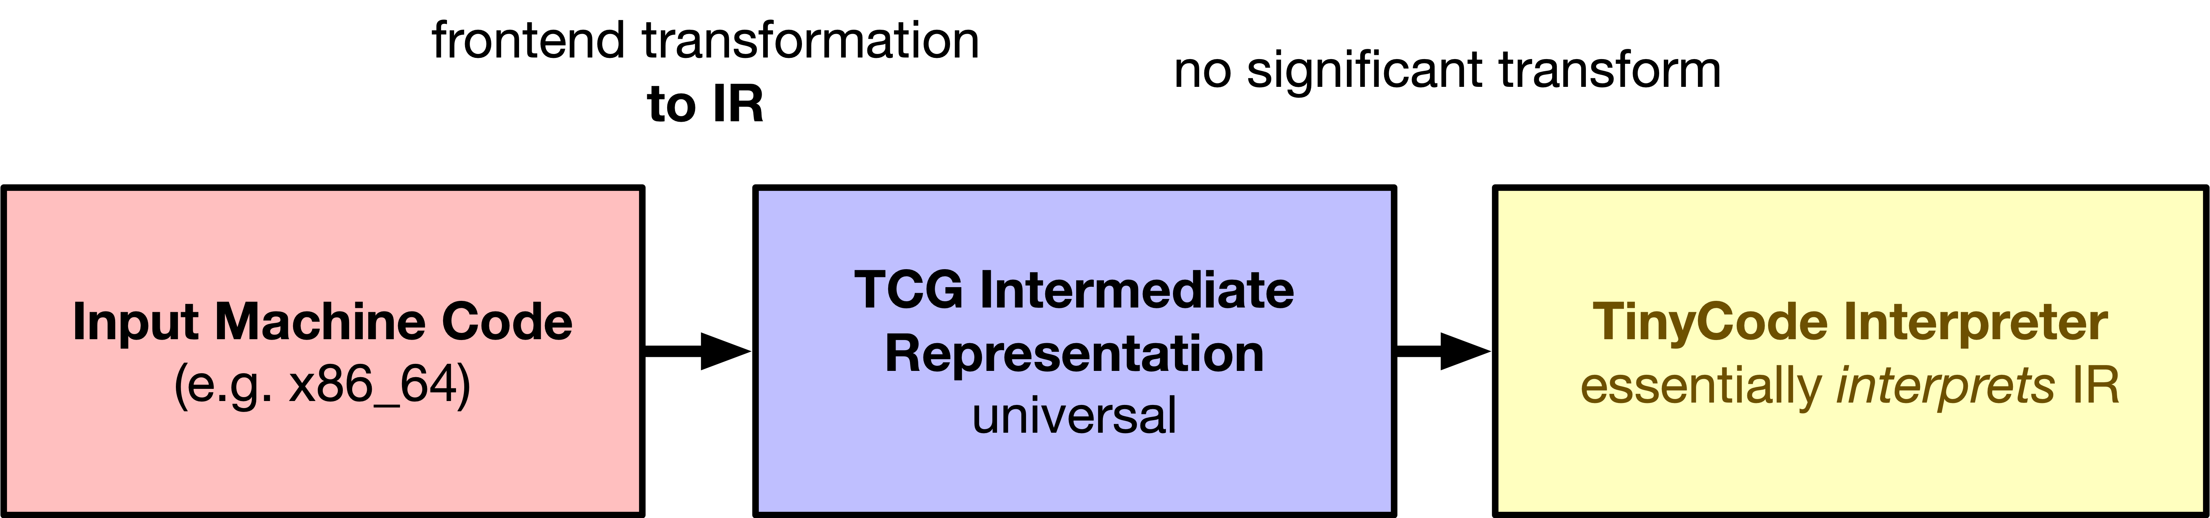
xorl %r8d, %r8d
movl $0x40000, %ecx
movl $0x100, %edx
movl $0x100, %esi
movq $18446744071850834489, %rdi
ONE OPTION:
RUNNING A VM on a VM

Slide 18
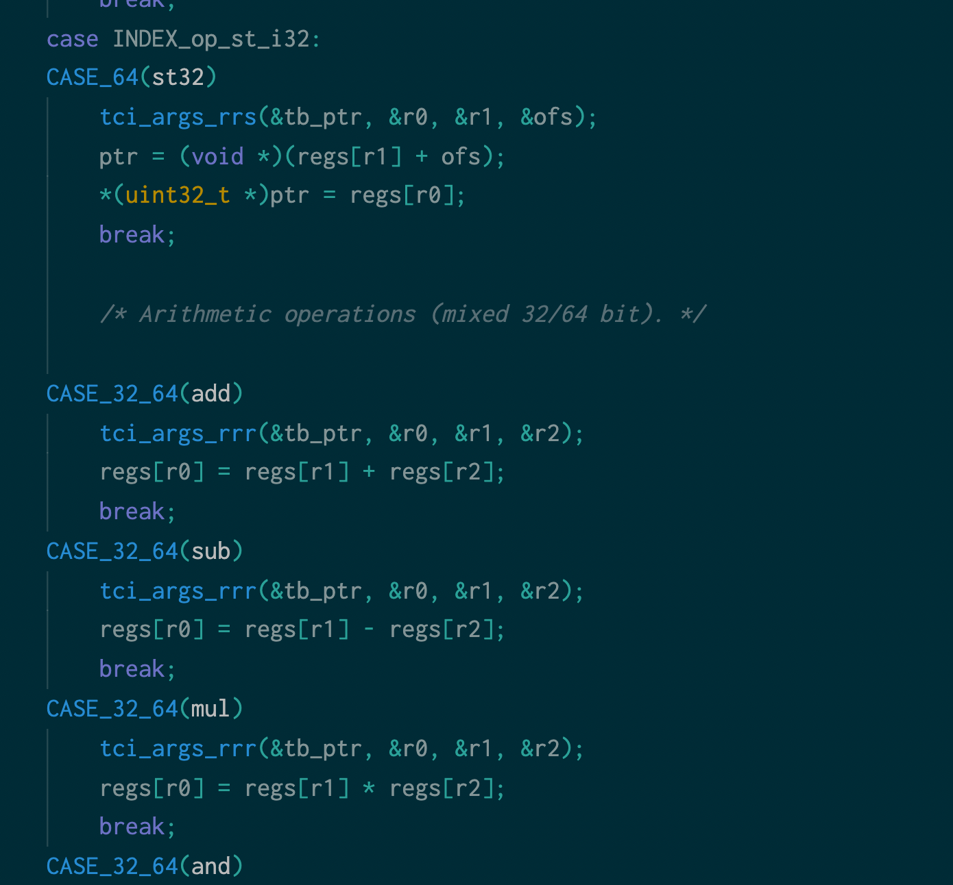
The issue?
TCI is SLOW

Slide 19


Slide 20
WE can’t RUN GENERATED CODE.
WE can RUN PRE-MADE CODE.

Slide 21
WE can’t RUN GENERATED CODE.
WE can RUN PRE-MADE CODE.

Slide 22
WE can RUN PRE-MADE CODE.

Slide 23
WE can RUN PRE-MADE CODE.
...SO, WHAT iF WE PRE-GENERATE
ALL THE CODE WE MIGHT NEED?

Slide 24
mov_i64 r0,r1
mov x0,x1

Slide 25
mov_i64 x1,#400
add_i64 x0, x1, x2
mov x1,#400
add x0,x1,x2

Slide 26
“program list”
of gadgets
0xffaa0000
mov x0,x1
ldr x27,[x28],#8
br x27
0xffaa0000
0xffab0024
0xffaa0024
add x0,x1,x2
ldr x27,[x28],#8
br x27

Slide 27
“program list”
of gadgets
0xffaa0000
mov x0,x1
ldr x27,[x28],#8
br x27
0xffaa0000
0xffab0024
0xffaa0024
add x0,x1,x2
ldr x27,[x28],#8
br x27

Slide 28
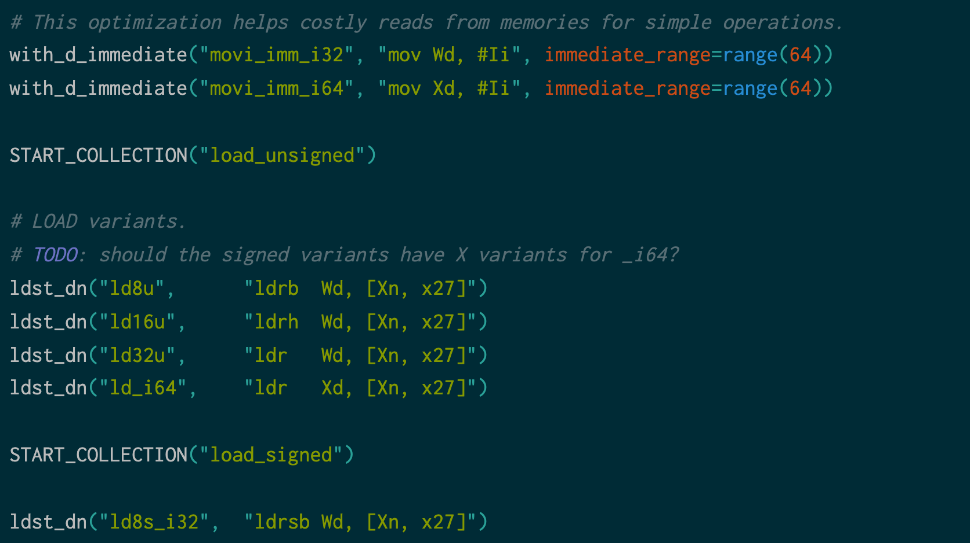

Slide 29
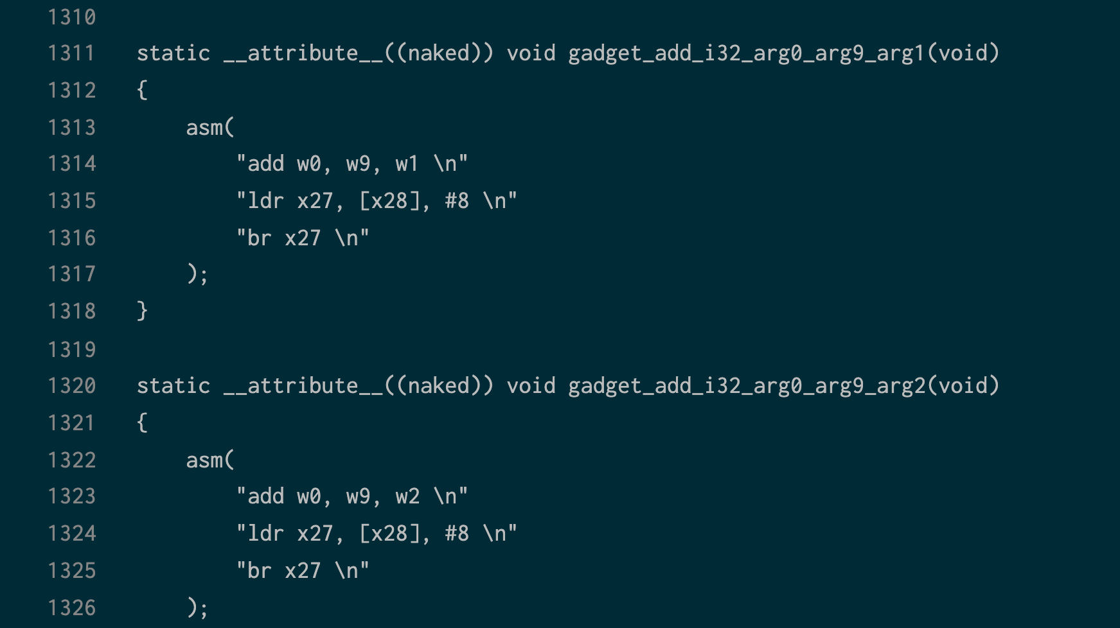

Slide 30
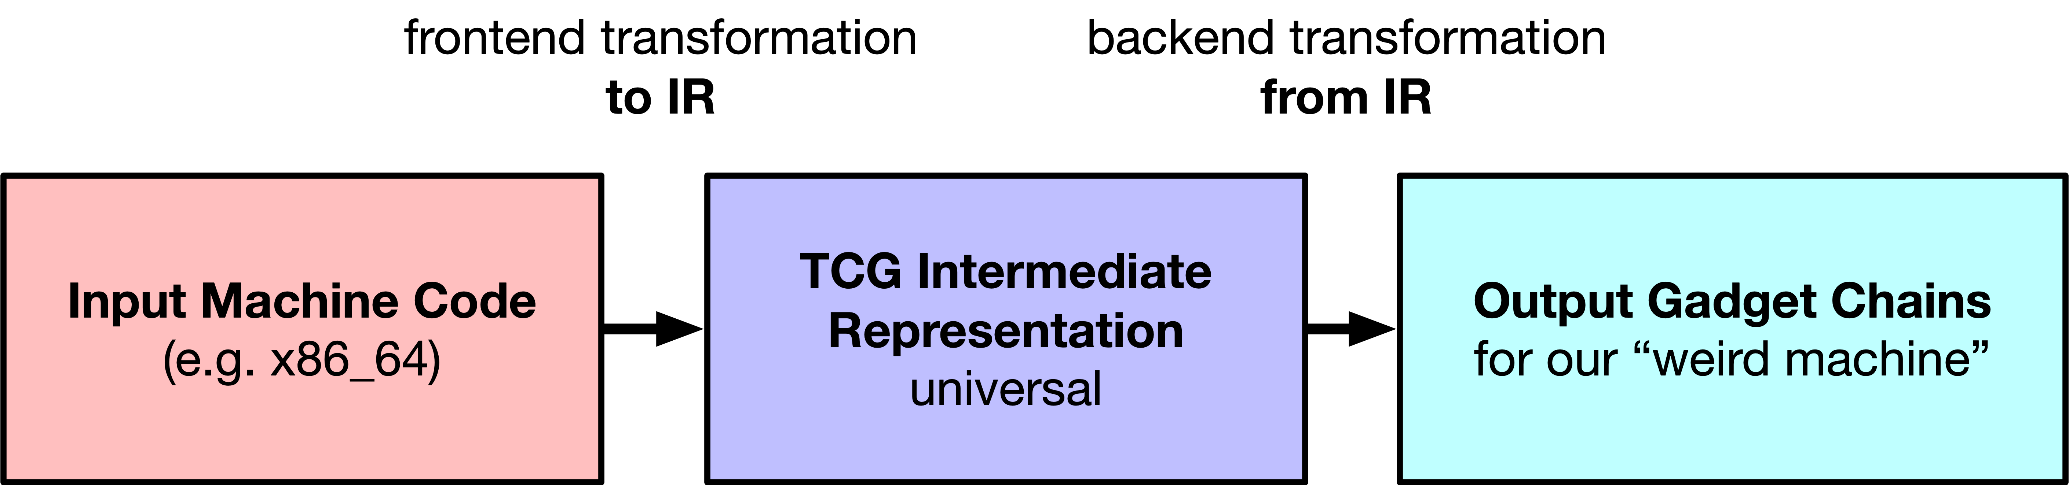

Slide 31
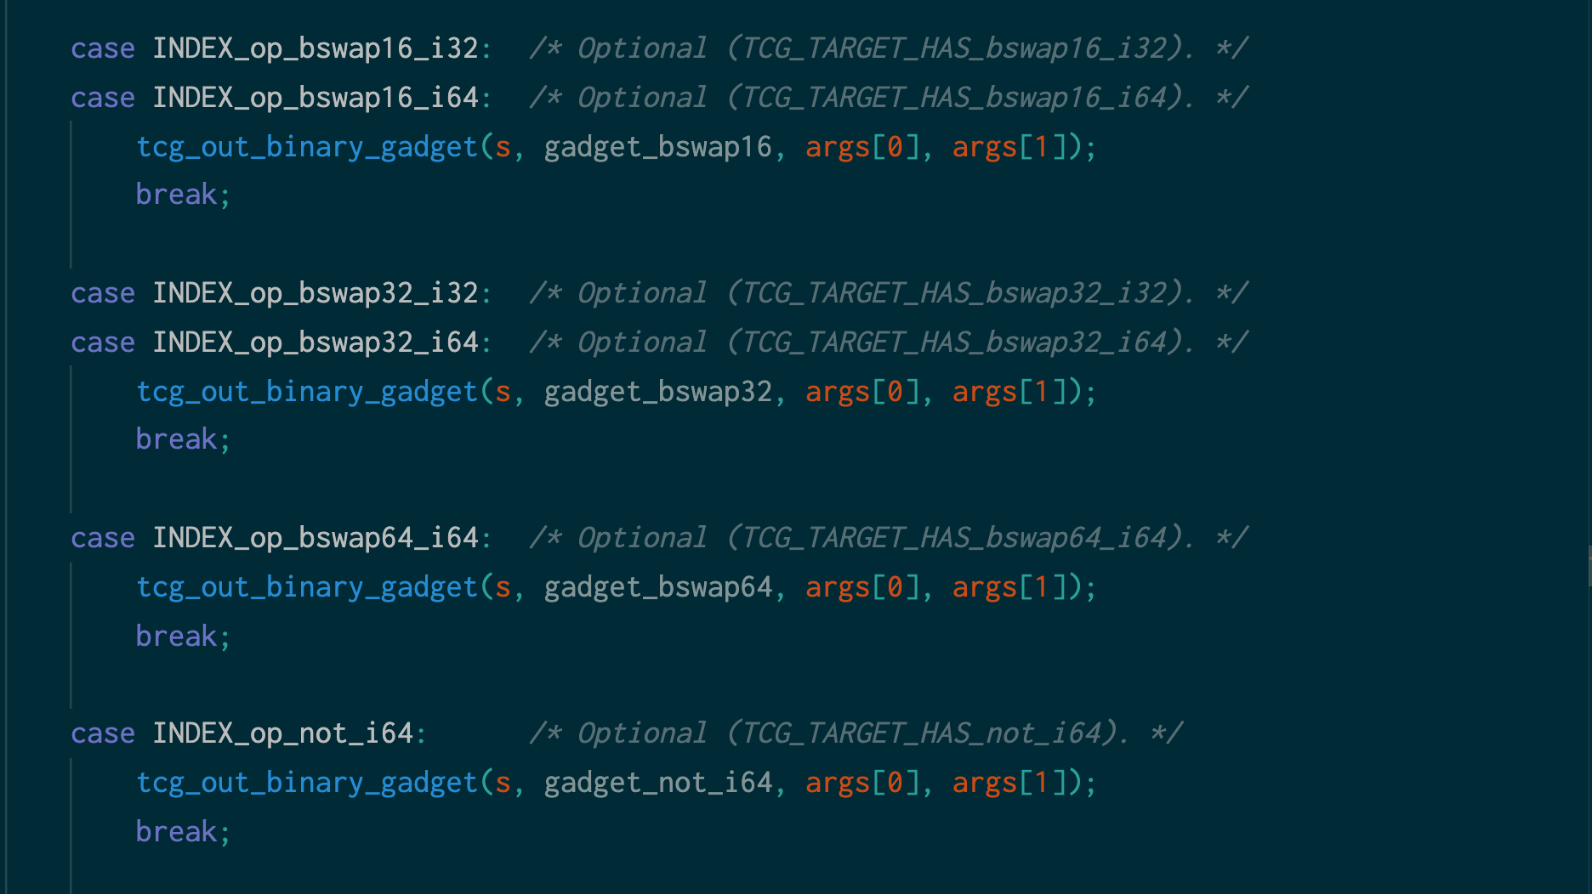

Slide 32
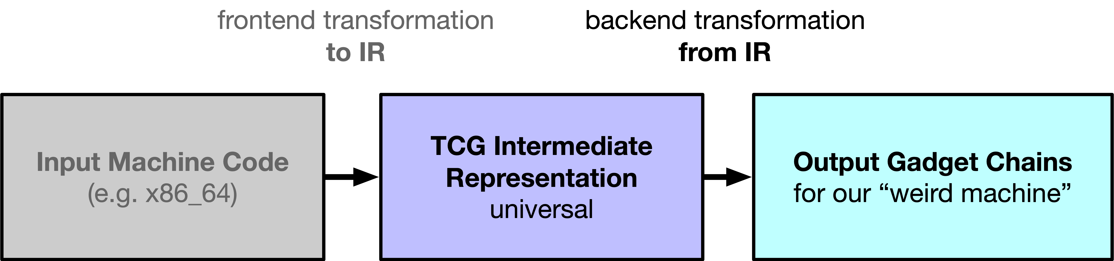
mov_i32 cc_op,$0x10
brcond_i64 cc_dst,$0x0,ne,$L1
goto_tb $0x0
st_i64 $0xe066,env,$0x80
exit_tb $0x280000200
gadget_movi_imm_i32_arg9_arg16
gadget_st_i32_sh8_imm_arg9_arg14_arg21
gadget_movi_imm_i64_arg9_arg0
gadget_brcond_i64_ne_arg8_arg9
00000002800003d0
gadget_br
0000000000000000
gadget_movi_i64_arg8
000000000000e066
gadget_st_i64_sh8_imm_arg8_arg14_arg16
gadget_exit_tb
0000000280000200

Slide 33
gadget_movi_imm_i32_arg9_arg16
gadget_st_i32_sh8_imm_arg9_arg14_arg21
gadget_movi_imm_i64_arg9_arg0
gadget_brcond_i64_ne_arg8_arg9
00000002800003d0
gadget_br
0000000000000000
gadget_movi_i64_arg8
000000000000e066
gadget_st_i64_sh8_imm_arg8_arg14_arg16
gadget_exit_tb
0000000280000200
mov w9, #16
st w9, [x14, #21]
mov x9, #0
cmp x8, w9
bne 0x02800003d0
b <target address after relocation*>
ldr x8, =#0xe066
st x8 [x14, #16]
ldr x0, =0x280000200
ret

Slide 34


Slide 35

🤭
STATUS: COMPUTATIONALLY FORBIDDEN
STATUS: FORBIDDEN, STILL COMPUTING

Slide 37
LESSONS LEARNED:
WHEN LIFE FORBIDS YOU FROM COMPUTING
SPARK JOY WITH A NEWER, WEIRDER COMPUTER

Slide 38
[QUESTIONS&ANSWERS]

